Slide 1

Summer Internship Presentation
Name- Raunak Nag
Er. No- 201B374
Course: BTECH
Branch: CSE
Semester: 7TH
Batch: 2020-2024

Slide 2
INTRODUCTION
Name of Institute: International Institute of Information Technology, Hyderabad (IIIT-H)
Project: Generating Synthetic Word Images for training Indian Scripts Scene Text OCR
Corporate Guide: Prof CV Jawahar
Faculty Guide: Ajoy Mondal
Period of Internship: 2 Months (12-Jun-2023 - 7-Aug-2023 )
Designation: SRFP CVIT Intern

Slide 3
OBJECTIVE
The Presentation is prepared based on my Two-month internship at CVIT Department in IIIT Hyderabad, Telangana, India.
The project is based in the field of Computer Vision in Artificial Intelligence and Machine Learning.
My task mainly included developing and modifying an existing python script to generate a synthetic word images dataset for Indian regional scripts especially for Bengali language.
This presentation displays the daily progress of my weekly tasks that I have undergone during my internship duration.

Slide 4

ABOUT THE INSTITUTE
Institute Name: - International Institute of Information Technology, Hyderabad, India
Founder: -Narendra Ahuja
Institute Type: - Engineering
Location: - Gachibowli, Hyderabad, Telangana, India
Type: -Public-Private Institute
Founded: -1998
Mission: - To contribute to transforming industry and society, by delivering research led education, promoting innovation, and fostering human values.

Slide 5
PROJECT INTRODUCTION
OCR for Indian scripts scene text is a difficult task due to the complexity of the scripts and the lack of training data
Synthetic data generation allows us to quickly generate large amounts of training data that can be used to train OCR models.
With this, we can improve the accuracy of current OCR models used for scene text recognition and can lead to better performance in results.
Moreover, we can also add different types of variations in synthetic data which may not be possible sometimes in real data

Slide 6
CHALLENGES
The different shapes and sizes of characters, combined with the presence of ligatures and diacritics, make it difficult for OCR models to accurately recognize and transcribe the text in Indian languages
There is also a lack of training data available for Indian scripts scene text OCR which makes it harder to develop accurate OCR models that can handle the diversity of the Indian scripts

Slide 7
IMPORTANCE
Synthetic data plays a crucial role in training OCR models for Indian scripts scene text. It provides a cost-effective and scalable solution to overcome the challenges posed by the scarcity of real-world data
By generating synthetic word images, we can create a diverse and comprehensive dataset that covers all possible variations of Indian scripts scene text
Synthetic data allows us to augment our existing datasets and improve the performance of our OCR models

Slide 8
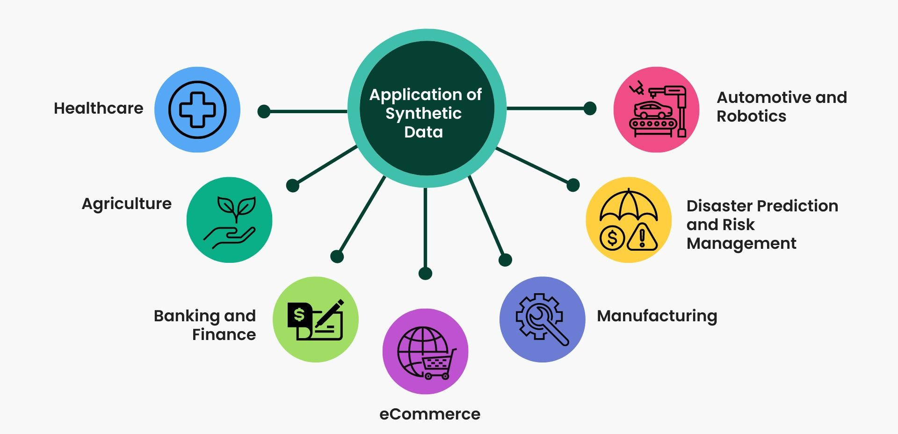
APPLICATIONS

Slide 9
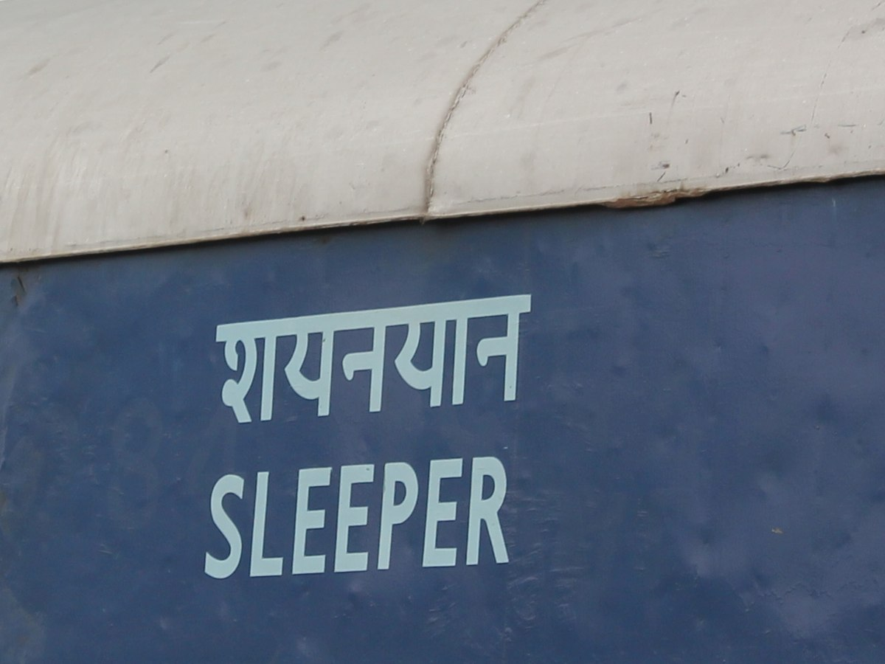

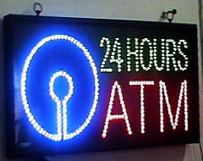
EXAMPLES OF REAL SCENE TEXT

Slide 10
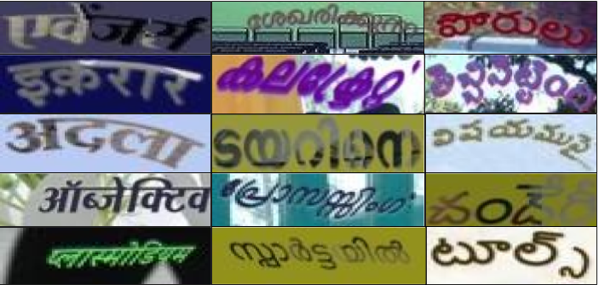
EXAMPLES OF SYNTHETIC SCENE TEXT

Slide 11
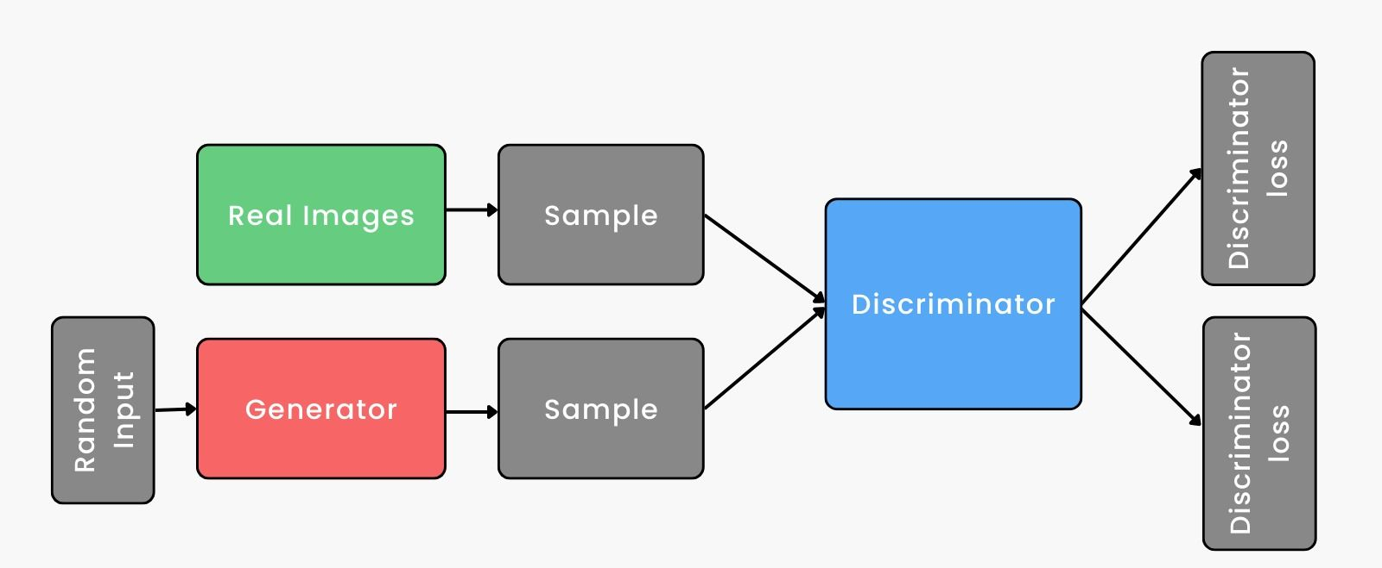
PROCESS

Slide 12




PRE-REQUISITES
ImageMagick
PangoCairo
Cairo
Pango

Slide 13
INPUTS
Indian Language
Vocabulary File
Language Fonts

Slide 14
PROCEDURE
Steps involved in Generating Synthetic Data
Data Preparation and Data Collection
Reading the vocabulary file
Choosing various rendering parameters
Image processing
Rendering Image

Slide 15



EXAMPLES OF GENERATED BENGALI SYNTHETIC SCENE TEXT

Slide 16
LEARNINGS
Understanding what is synthetic data and why it is required
Understanding about scene text and its different variations in Indian scripts
To know and understand different ways of synthetic data generation.
To learn how to read research papers and research articles

Slide 17
CONCLUSION
Generating synthetic word images for training Indian scripts scene text OCR is a crucial step towards improving the accuracy of OCR models
Data augmentation techniques can also be used to further enhance the synthetic dataset.
Through 8 weeks of internship, I have grown rapidly in a professional explored research in computer science
I was able to interact with my peers and fellows which also helped me enhance my communication skills

Slide 18

THANKYOU

